Slide 1

Mr. Amol Jadhav Assistant Professor Department of Mathematics Vidya Pratishthan’s Kamalnayan Bajaj Institute of Engineering and Technology, Baramati
Subject: Engineering Mathematics-III Topic: Inverse Z-Transform
Application to solution of Difference Equation Lecture No.- 08

Slide 2
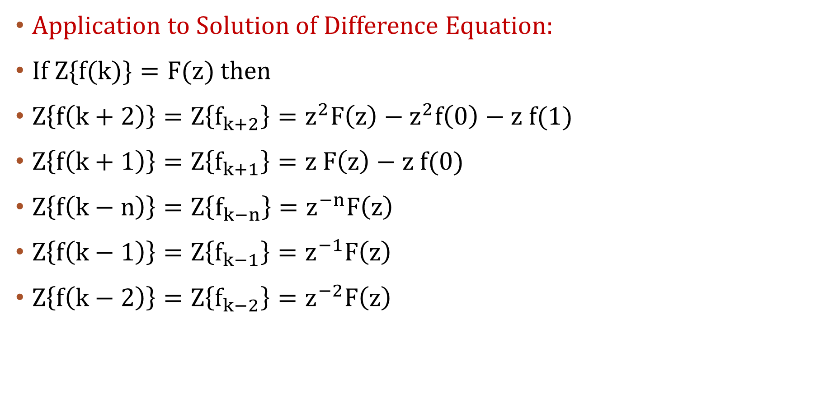
INVERSE Z-Transform
Application to Solution of Difference Equation:
If$Z\{f(k)\}=F(z)$ then
$Z\left\{f\left(k+2\right)\right\}=Z\left\{f_{k+2}\right\}=z^{2}F\left(z\right)−z^{2}f\left(0\right)−z f(1)$
$Z\left\{f\left(k+1\right)\right\}=Z\left\{f_{k+1}\right\}=z F\left(z\right)−z f(0)$
$Z\left\{f\left(k−n\right)\right\}=Z\left\{f_{k−n}\right\}=z^{−n}F\left(z\right)$
$Z\left\{f\left(k−1\right)\right\}=Z\left\{f_{k−1}\right\}=z^{−1}F\left(z\right)$
$Z\left\{f\left(k−2\right)\right\}={Z\left\{f_{k−2}\right\}=z}^{−2}F\left(z\right)$

Slide 3
Working rules to solve difference equation:
Step 1: Take Z transform on both sides of given equation.
Step2: Put given conditions.
Step 3: Collect the terms containing F(z) to LHS. and remaining RHS.
Step 4: Simplify F(z) by dividing coefficient of F(z).
Step 5: Express R. H. S. in terms of standard Z transform.
Step 6: Take inverse Z transform of both sides and gives f(k).

Slide 4
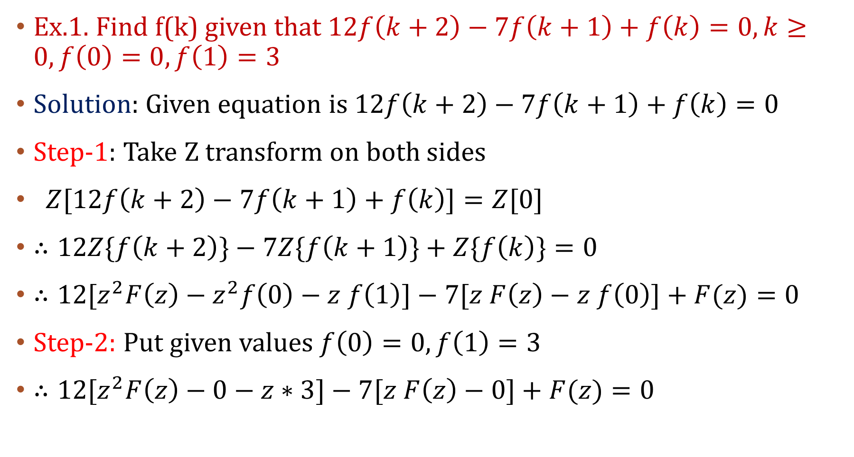
Ex.1. Find f(k) given that$12f\left(k+2\right)−7f\left(k+1\right)+f\left(k\right)=0, k≥0, f\left(0\right)=0, f\left(1\right)=3$
Solution: Given equation is $12f\left(k+2\right)−7f\left(k+1\right)+f\left(k\right)=0$
Step-1: Take Z transform on both sides
$Z[12f\left(k+2\right)−7f\left(k+1\right)+f\left(k\right)]=Z[0]$
$∴12Z\{f\left(k+2\right)\}−7Z\{f\left(k+1\right)\}+Z\{f\left(k\right)\}=0$
$∴12[z^{2}F\left(z\right)−z^{2}f\left(0\right)−z f\left(1\right)]−7[z F\left(z\right)−z f\left(0\right)]+F(z)=0$
Step-2: Put given values $f\left(0\right)=0, f\left(1\right)=3$
$∴12[z^{2}F\left(z\right)−0−z∗3]−7[z F\left(z\right)−0]+F(z)=0$

Slide 5
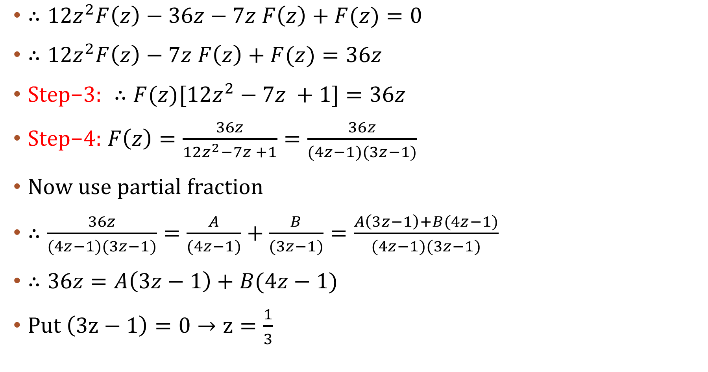
$∴12z^{2}F\left(z\right)−36z−7z F\left(z\right)+F(z)=0$
$∴12z^{2}F\left(z\right)−7z F\left(z\right)+F(z)=36z$
$\text{Step}\text{−3:} ∴F(z)[12z^{2}−7z +1]=36z$
$\text{Step}\text{−4:} F\left(z\right)=\frac{36z}{12z^{2}−7z +1}=\frac{36z}{(4z−1)(3z−1)}$
Now use partial fraction
$∴\frac{36z}{(4z−1)(3z−1)}=\frac{A}{(4z−1)}+\frac{B}{(3z−1)}=\frac{A\left(3z−1\right)+B(4z−1)}{(4z−1)(3z−1)}$
$∴36z=A\left(3z−1\right)+B(4z−1)$
Put$\left(3z−1\right)=0→z=\frac{1}{3}$

Slide 6
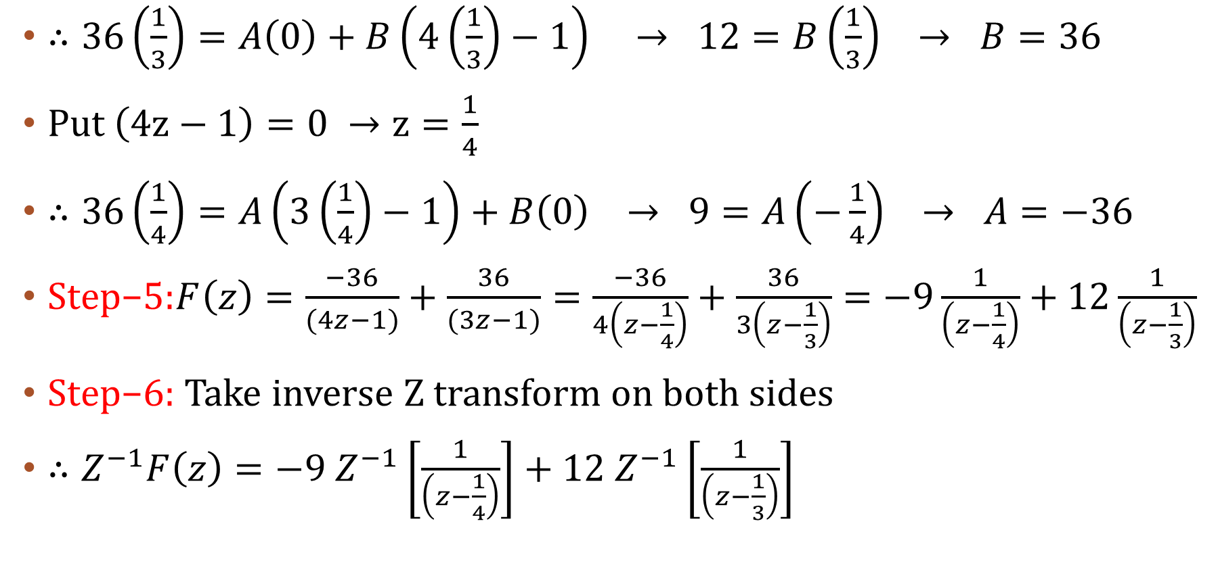
$∴36\left(\frac{1}{3}\right)=A\left(0\right)+B\left(4\left(\frac{1}{3}\right)−1\right) → 12=B\left(\frac{1}{3}\right) → B=36$
Put $\left(4z−1\right)=0 →z=\frac{1}{4}$
$∴36\left(\frac{1}{4}\right)=A\left(3\left(\frac{1}{4}\right)−1\right)+B\left(0\right) → 9=A\left(−\frac{1}{4}\right) → A=−36$
$\text{Step}\text{−5:}F\left(z\right)=\frac{−36}{(4z−1)}+\frac{36}{(3z−1)}=\frac{−36}{4\left(z−\frac{1}{4}\right)}+\frac{36}{3\left(z−\frac{1}{3}\right)}=−9\frac{1}{\left(z−\frac{1}{4}\right)}+12\frac{1}{\left(z−\frac{1}{3}\right)}$
$\text{Step}\text{−6:}$Take inverse Z transform on both sides
$∴Z^{−1}F\left(z\right)=−9 Z^{−1}\left[\frac{1}{\left(z−\frac{1}{4}\right)}\right]+12 Z^{−1}\left[\frac{1}{\left(z−\frac{1}{3}\right)}\right]$

Slide 7
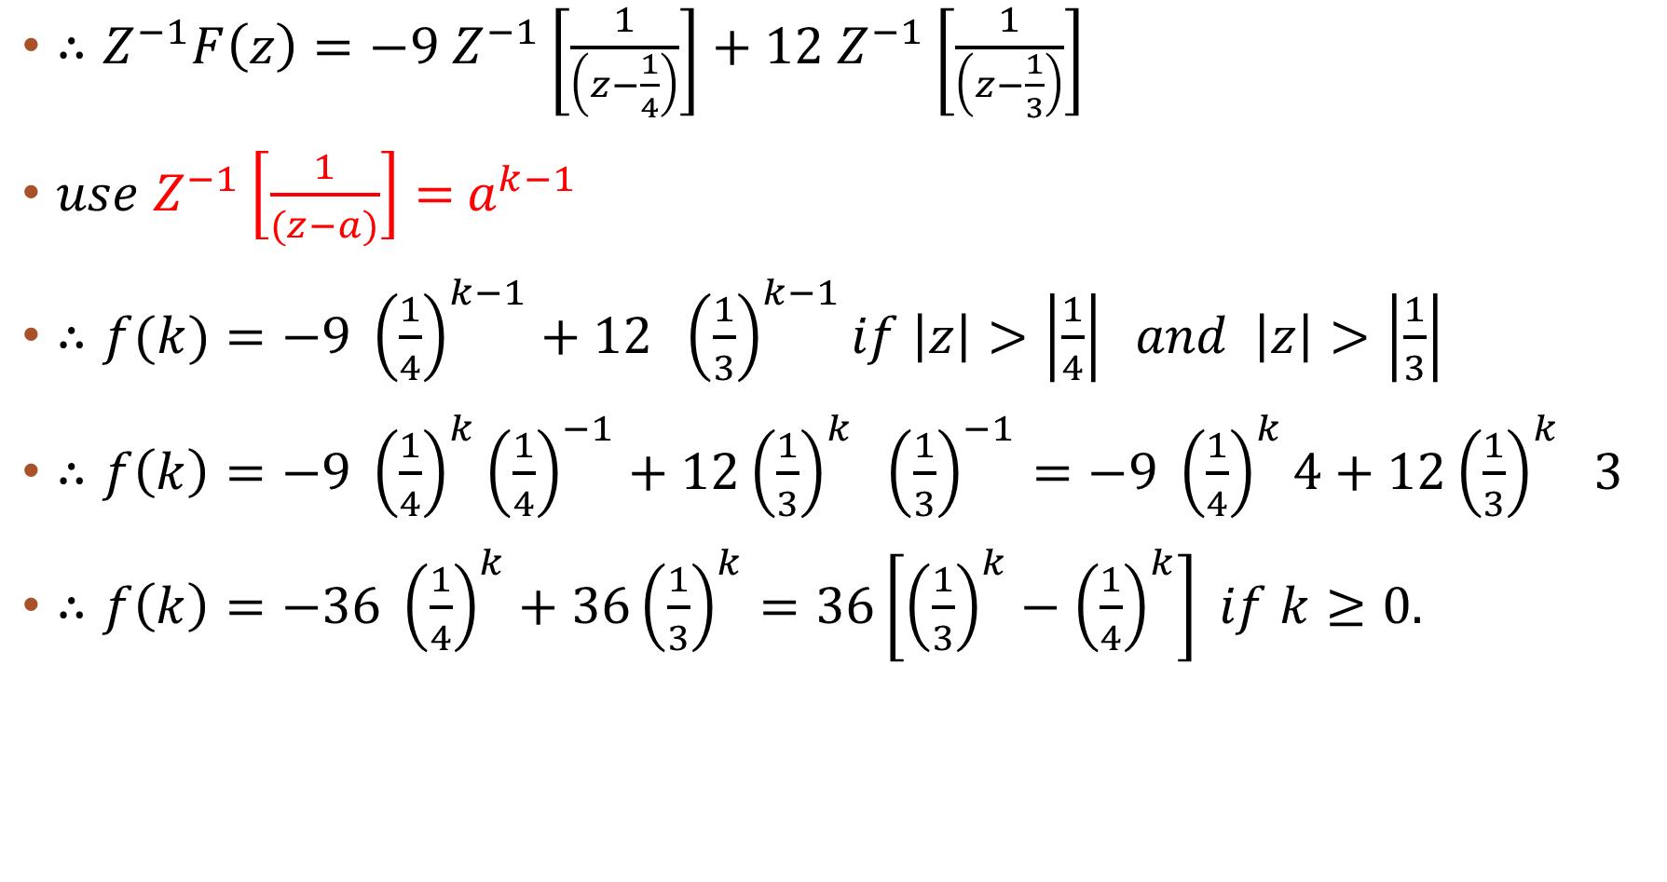
$∴Z^{−1}F\left(z\right)=−9 Z^{−1}\left[\frac{1}{\left(z−\frac{1}{4}\right)}\right]+12 Z^{−1}\left[\frac{1}{\left(z−\frac{1}{3}\right)}\right]$
$use{ Z}^{−1}\left[\frac{1}{(z−a)}\right]={ a}^{k−1}$
$∴f(k)=−9 {\left(\frac{1}{4}\right)}^{k−1}+12 {\left(\frac{1}{3}\right)}^{k−1}if \left|z\right|>\left|\frac{1}{4}\right| and \left|z\right|>\left|\frac{1}{3}\right|$
$∴f\left(k\right)=−9 {\left(\frac{1}{4}\right)}^{k}{\left(\frac{1}{4}\right)}^{−1}+12{\left(\frac{1}{3}\right)}^{k} {\left(\frac{1}{3}\right)}^{−1}=−9 {\left(\frac{1}{4}\right)}^{k}4+12{\left(\frac{1}{3}\right)}^{k} 3$
$∴f\left(k\right)=−36 {\left(\frac{1}{4}\right)}^{k}+36{\left(\frac{1}{3}\right)}^{k}=36\left[{\left(\frac{1}{3}\right)}^{k}−{\left(\frac{1}{4}\right)}^{k}\right] if k≥0.$

Slide 8
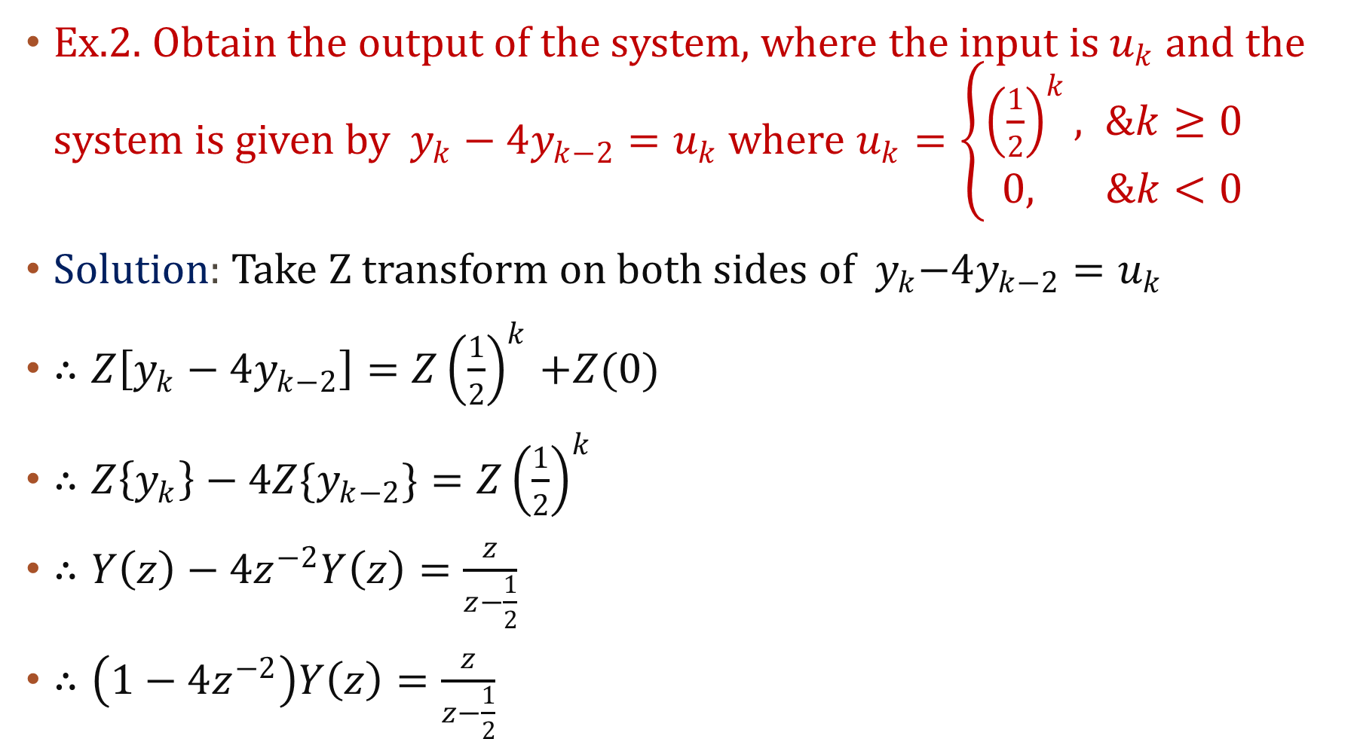
Ex.2. Obtain the output of the system, where the input is $u_{k}$ and the system is given by $y_{k}−4y_{k−2}=u_{k}$ where $u_{k}=\left\{\begin{aligned}{\left(\frac{1}{2}\right)}^{k}, &k≥0 \\ 0, &k<0\end{aligned}\right.$
Solution: Take Z transform on both sides of${ y}_{k}−4y_{k−2}=u_{k}$
$∴Z\left[y_{k}−4y_{k−2}\right]{=Z\left(\frac{1}{2}\right)}^{k}+Z(0)$
$∴Z\left\{y_{k}\right\}−4{Z\{y}_{k−2}\}{=Z\left(\frac{1}{2}\right)}^{k}$
$∴Y\left(z\right)−4z^{−2}Y\left(z\right)=\frac{z}{z−\frac{1}{2}}$
$∴\left(1−4z^{−2}\right)Y\left(z\right)=\frac{z}{z−\frac{1}{2}}$

Slide 9
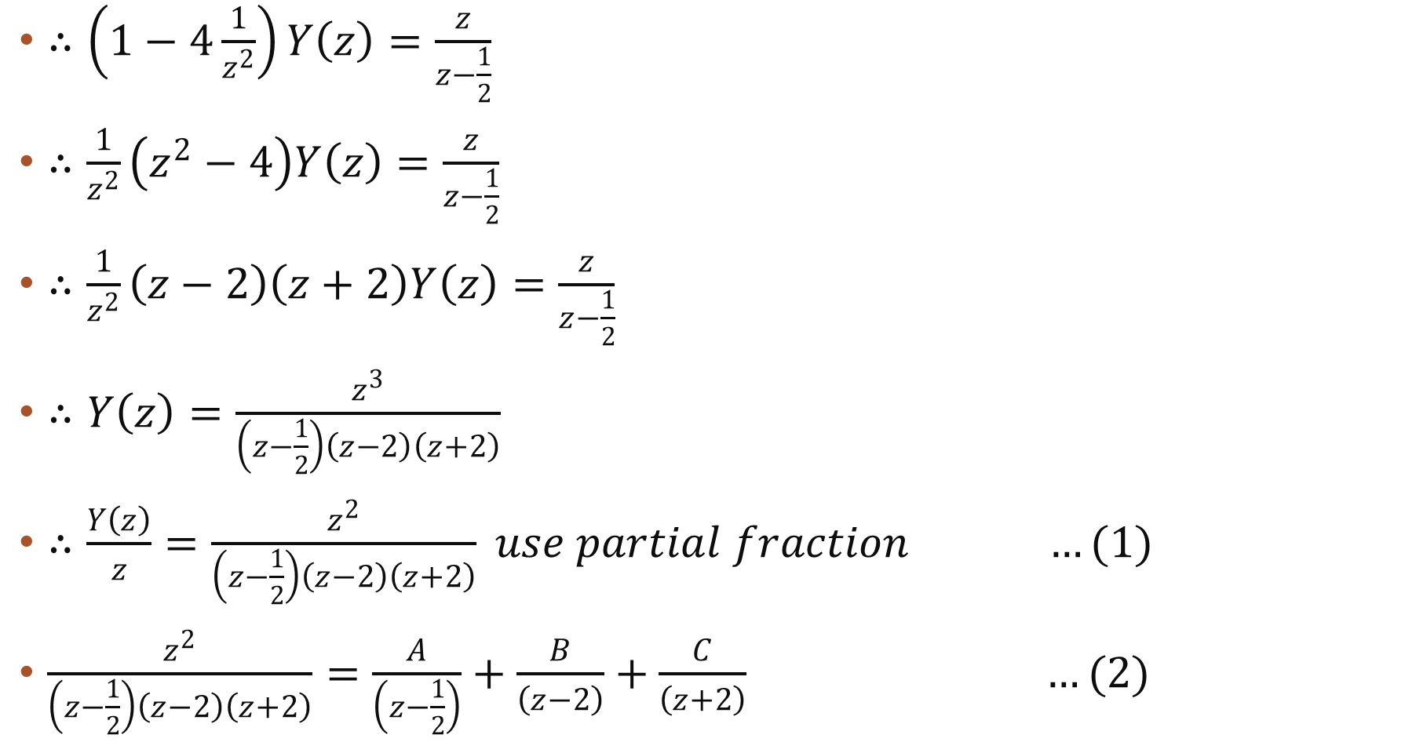
$∴\left(1−4\frac{1}{z^{2}}\right)Y\left(z\right)=\frac{z}{z−\frac{1}{2}}$
$∴\frac{1}{z^{2}}\left(z^{2}−4\right)Y\left(z\right)=\frac{z}{z−\frac{1}{2}}$
$∴\frac{1}{z^{2}}\left(z−2\right)\left(z+2\right)Y\left(z\right)=\frac{z}{z−\frac{1}{2}}$
$∴Y\left(z\right)=\frac{z^{3}}{\left(z−\frac{1}{2}\right)\left(z−2\right)\left(z+2\right)}$
$∴\frac{Y\left(z\right)}{z}=\frac{z^{2}}{\left(z−\frac{1}{2}\right)\left(z−2\right)\left(z+2\right)} use partial fraction …(1)$
$\frac{z^{2}}{\left(z−\frac{1}{2}\right)\left(z−2\right)\left(z+2\right)}=\frac{A}{\left(z−\frac{1}{2}\right)}+\frac{B}{\left(z−2\right)}+\frac{C}{\left(z+2\right)} …(2)$

Slide 10
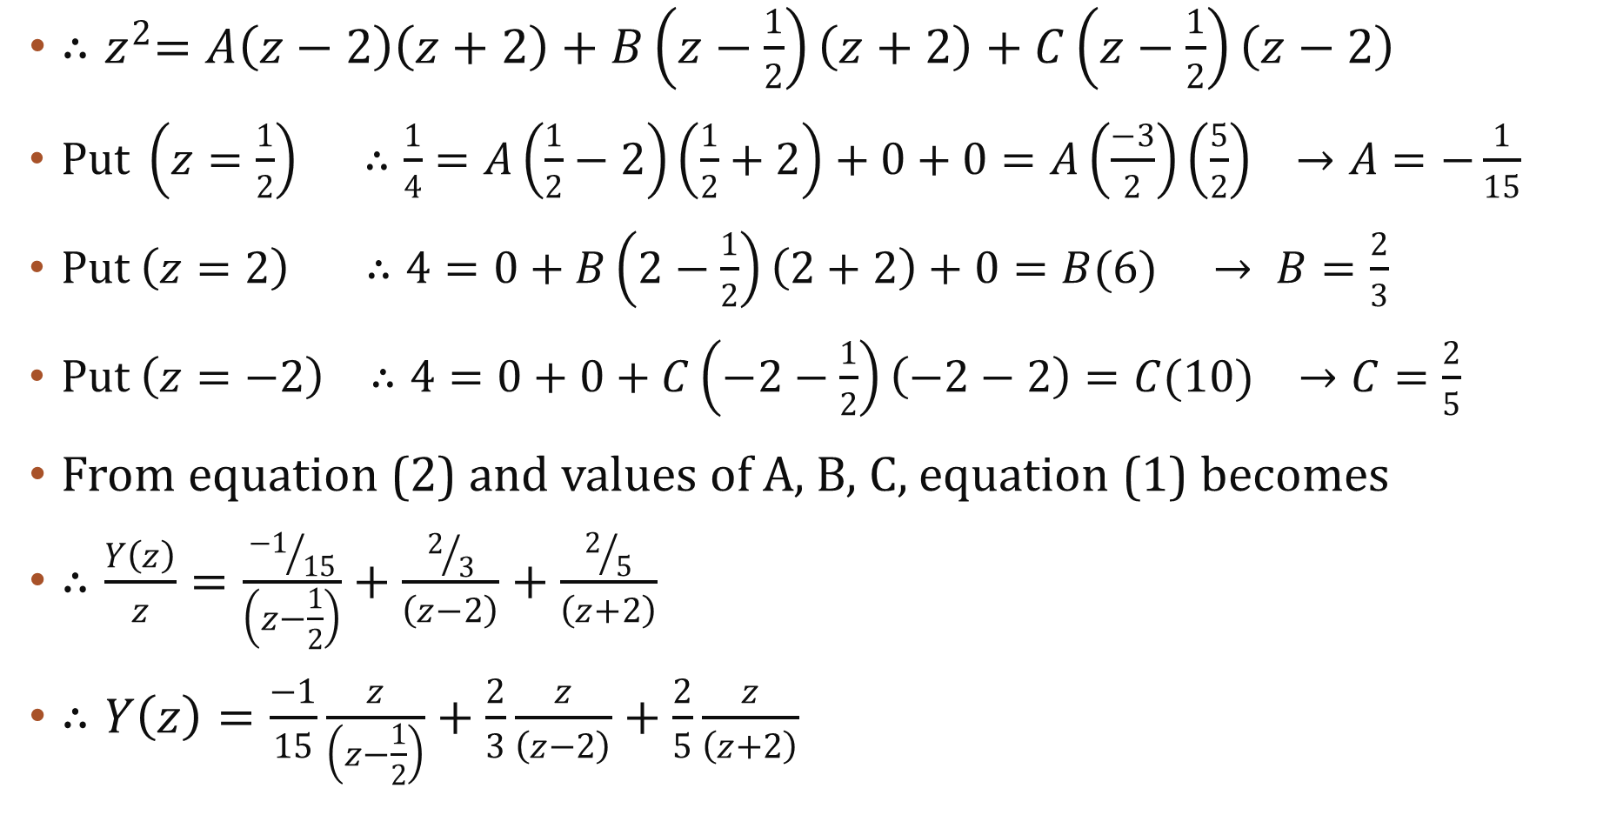
${∴z}^{2}=A\left(z−2\right)\left(z+2\right)+B\left(z−\frac{1}{2}\right)\left(z+2\right)+C\left(z−\frac{1}{2}\right)\left(z−2\right)$
$Put \left(z=\frac{1}{2}\right) ∴\frac{1}{4}=A\left(\frac{1}{2}−2\right)\left(\frac{1}{2}+2\right)+0+0=A\left(\frac{−3}{2}\right)\left(\frac{5}{2}\right) →A=−\frac{1}{15}$
$Put \left(z=2\right) ∴4=0+B\left(2−\frac{1}{2}\right)\left(2+2\right)+0=B(6) → B=\frac{2}{3}$
$Put \left(z=−2\right) ∴4=0+0+C\left(−2−\frac{1}{2}\right)\left(−2−2\right)=C(10) →C=\frac{2}{5}$
From equation (2) and values of A, B, C, equation (1) becomes
$∴\frac{Y\left(z\right)}{z}=\frac{{−1}/{15}}{\left(z−\frac{1}{2}\right)}+\frac{2/3}{\left(z−2\right)}+\frac{2/5}{\left(z+2\right)}$
$∴Y\left(z\right)=\frac{−1}{15}\frac{z}{\left(z−\frac{1}{2}\right)}+\frac{2}{3}\frac{z}{\left(z−2\right)}+\frac{2}{5}\frac{z}{\left(z+2\right)}$

Slide 11

$∴Y\left(z\right)=\frac{−1}{15}\frac{z}{\left(z−\frac{1}{2}\right)}+\frac{2}{3}\frac{z}{\left(z−2\right)}+\frac{2}{5}\frac{z}{\left(z+2\right)}$
Take inverse Z transform
$∴Z^{−1}Y\left(z\right)=\frac{−1}{15}Z^{−1}\left[\frac{z}{\left(z−\frac{1}{2}\right)}\right]+\frac{2}{3}Z^{−1}\left[\frac{z}{\left(z−2\right)}\right]+\frac{2}{5}Z^{−1}\left[\frac{z}{\left(z+2\right)}\right]$
$Use Z^{−1}\left[\frac{z}{(z−a)}\right]={ a}^{k}$
$∴y\left(k\right)=−\frac{1}{15}{\left(\frac{1}{2}\right)}^{k}+\frac{2}{3}{\left(2\right)}^{k}+\frac{2}{5}{\left(−2\right)}^{k} ; k≥0.$

Slide 12
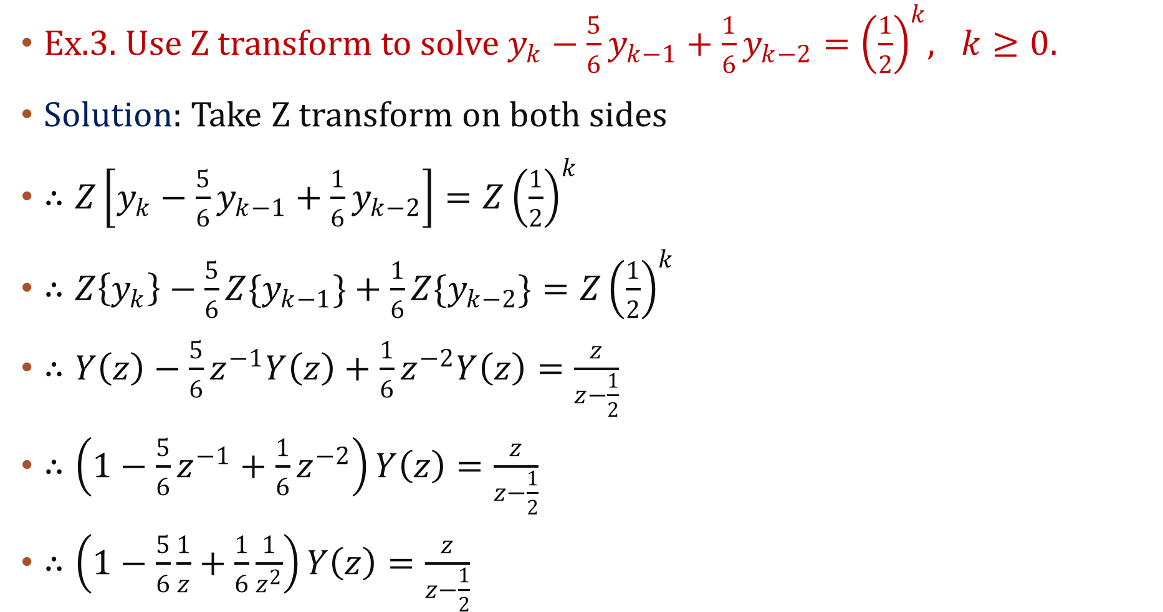
Ex.3. Use Z transform to solve$y_{k}−\frac{5}{6}y_{k−1}+\frac{1}{6}y_{k−2}{=\left(\frac{1}{2}\right)}^{k}, k≥0.$
Solution: Take Z transform on both sides
$∴Z\left[y_{k}−\frac{5}{6}y_{k−1}+\frac{1}{6}y_{k−2}\right]{=Z\left(\frac{1}{2}\right)}^{k}$
$∴Z\left\{y_{k}\right\}−\frac{5}{6}{Z\{y}_{k−1}\}+\frac{1}{6}Z\{y_{k−2}\}{=Z\left(\frac{1}{2}\right)}^{k}$
$∴Y\left(z\right)−\frac{5}{6}z^{−1}Y\left(z\right)+\frac{1}{6}z^{−2}Y\left(z\right)=\frac{z}{z−\frac{1}{2}}$
$∴\left(1−\frac{5}{6}z^{−1}+\frac{1}{6}z^{−2}\right)Y\left(z\right)=\frac{z}{z−\frac{1}{2}}$
$∴\left(1−\frac{5}{6}\frac{1}{z}+\frac{1}{6}\frac{1}{z^{2}}\right)Y\left(z\right)=\frac{z}{z−\frac{1}{2}}$

Slide 13
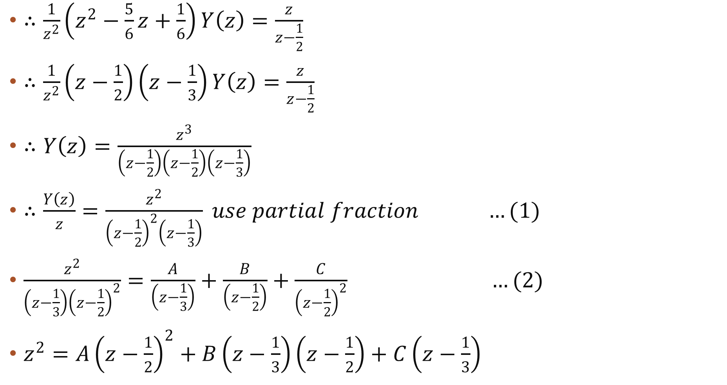
$∴\frac{1}{z^{2}}\left(z^{2}−\frac{5}{6}z+\frac{1}{6}\right)Y\left(z\right)=\frac{z}{z−\frac{1}{2}}$
$∴\frac{1}{z^{2}}\left(z−\frac{1}{2}\right)\left(z−\frac{1}{3}\right)Y\left(z\right)=\frac{z}{z−\frac{1}{2}}$
$∴Y\left(z\right)=\frac{z^{3}}{\left(z−\frac{1}{2}\right)\left(z−\frac{1}{2}\right)\left(z−\frac{1}{3}\right)}$
$∴\frac{Y\left(z\right)}{z}=\frac{z^{2}}{{\left(z−\frac{1}{2}\right)}^{2}\left(z−\frac{1}{3}\right)} use partial fraction …(1)$
$\frac{z^{2}}{{\left(z−\frac{1}{3}\right)\left(z−\frac{1}{2}\right)}^{2}}=\frac{A}{\left(z−\frac{1}{3}\right)}+\frac{B}{\left(z−\frac{1}{2}\right)}+\frac{C}{{\left(z−\frac{1}{2}\right)}^{2}} …(2)$
$z^{2}=A{\left(z−\frac{1}{2}\right)}^{2}+B\left(z−\frac{1}{3}\right)\left(z−\frac{1}{2}\right)+C\left(z−\frac{1}{3}\right)$

Slide 14
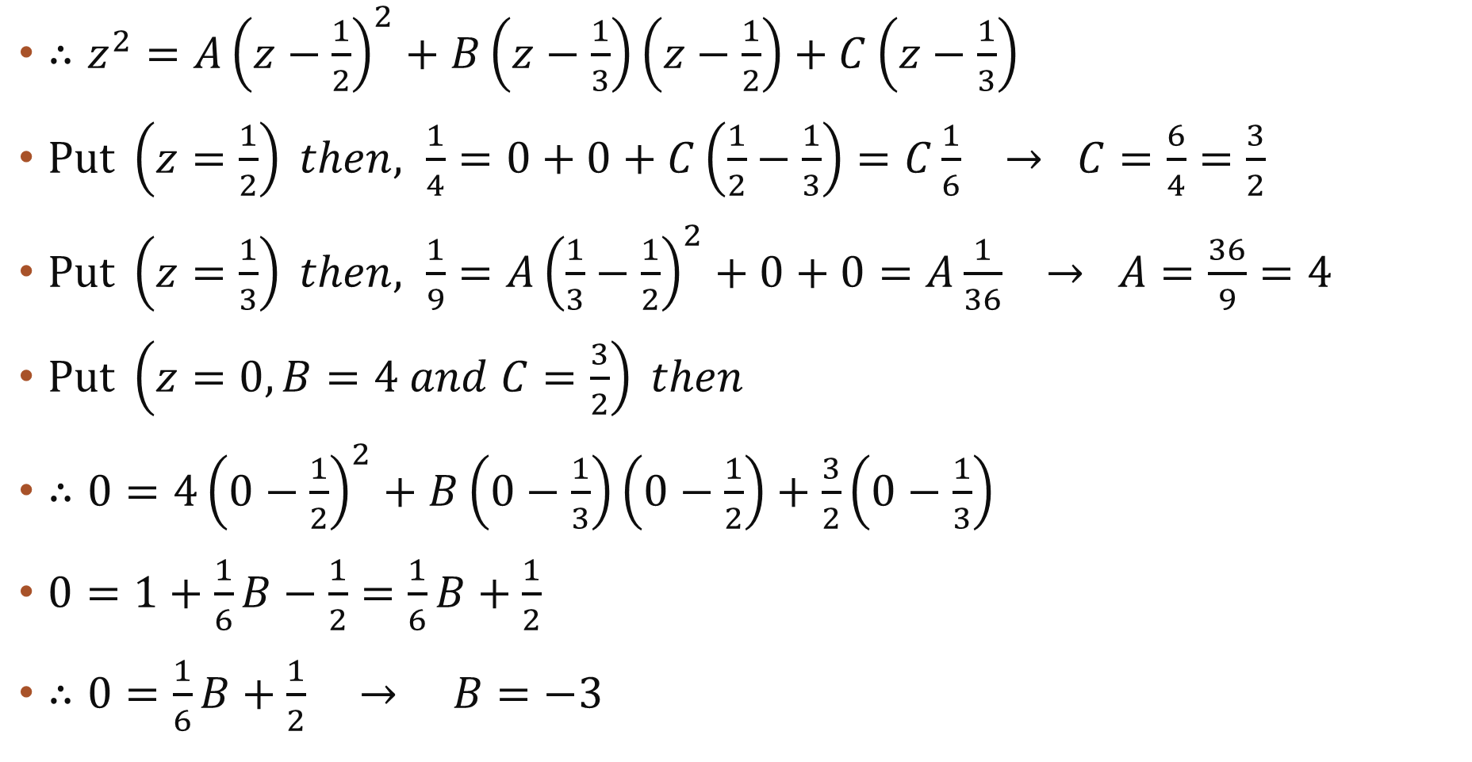
$∴z^{2}=A{\left(z−\frac{1}{2}\right)}^{2}+B\left(z−\frac{1}{3}\right)\left(z−\frac{1}{2}\right)+C\left(z−\frac{1}{3}\right)$
$Put \left(z=\frac{1}{2}\right) then, \frac{1}{4}=0+0+C\left(\frac{1}{2}−\frac{1}{3}\right)=C\frac{1}{6} → C=\frac{6}{4}=\frac{3}{2}$
$Put \left(z=\frac{1}{3}\right) then, \frac{1}{9}=A{\left(\frac{1}{3}−\frac{1}{2}\right)}^{2}+0+0=A\frac{1}{36} → A=\frac{36}{9}=4$
$Put \left(z=0, B=4 and C=\frac{3}{2}\right) then$
$∴0={4\left(0−\frac{1}{2}\right)}^{2}+B\left(0−\frac{1}{3}\right)\left(0−\frac{1}{2}\right)+\frac{3}{2}\left(0−\frac{1}{3}\right)$
$0=1+\frac{1}{6}B−\frac{1}{2}=\frac{1}{6}B+\frac{1}{2}$
$∴0=\frac{1}{6}B+\frac{1}{2} → B=−3$

Slide 15
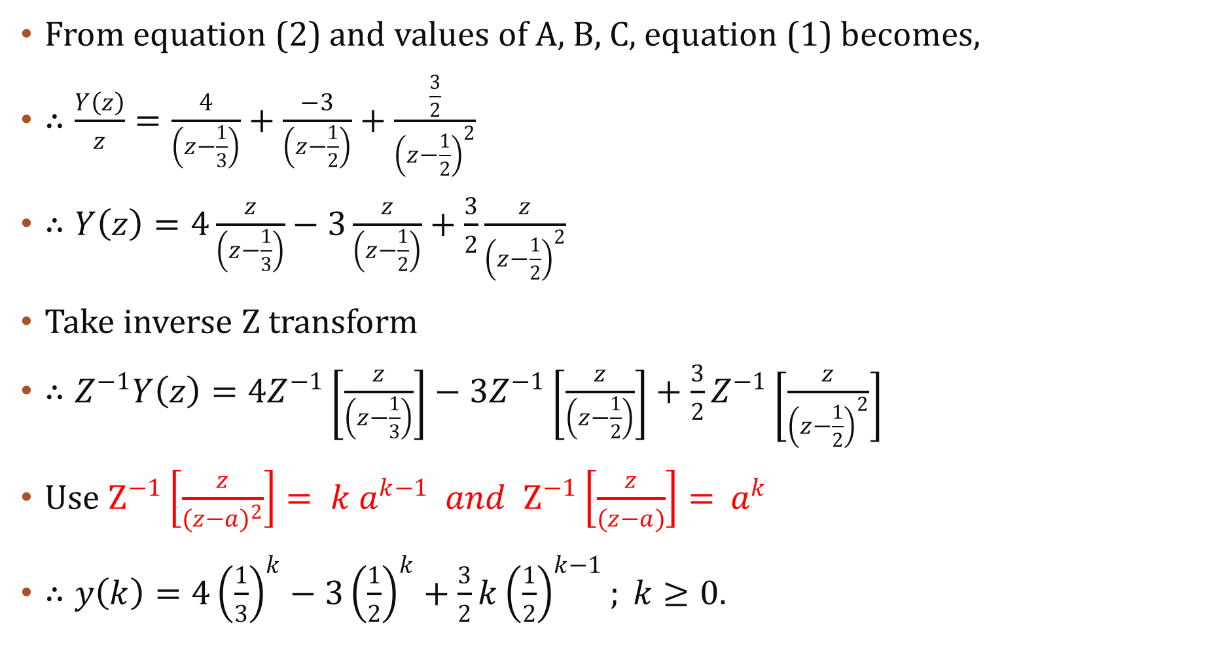
From equation (2) and values of A, B, C, equation (1) becomes,
$∴\frac{Y\left(z\right)}{z}=\frac{4}{\left(z−\frac{1}{3}\right)}+\frac{−3}{\left(z−\frac{1}{2}\right)}+\frac{\frac{3}{2}}{{\left(z−\frac{1}{2}\right)}^{2}}$
$∴Y\left(z\right)=4\frac{z}{\left(z−\frac{1}{3}\right)}−3\frac{z}{\left(z−\frac{1}{2}\right)}+\frac{3}{2}\frac{z}{{\left(z−\frac{1}{2}\right)}^{2}}$
Take inverse Z transform
$∴Z^{−1}Y\left(z\right)=4Z^{−1}\left[\frac{z}{\left(z−\frac{1}{3}\right)}\right]−3Z^{−1}\left[\frac{z}{\left(z−\frac{1}{2}\right)}\right]+\frac{3}{2}Z^{−1}\left[\frac{z}{{\left(z−\frac{1}{2}\right)}^{2}}\right]$
$Use Z^{−1}\left[\frac{z}{{(z−a)}^{2}}\right]={ k a}^{k−1} and Z^{−1}\left[\frac{z}{(z−a)}\right]={ a}^{k}$
$∴y\left(k\right)=4{\left(\frac{1}{3}\right)}^{k}−3{\left(\frac{1}{2}\right)}^{k}+\frac{3}{2}k{\left(\frac{1}{2}\right)}^{k−1}; k≥0.$

